Slide 1



Transmission Control Protocol (TCP)
Fundamental communication protocol in computer networking. It operates at the transport layer of the OSI model and plays a crucial role in ensuring reliable and orderly data transmission over the internet and other interconnected networks. It works hand in hand with the Internet Protocol (IP) to form the basis of the widely used TCP/IP protocol suite

Slide 2


Connection Oriented Protocol
Connection Oriented Protocol is one that establishes and maintains a logical connection b/w two devices.
This connection ensures that data is transmitted reliably and in the correct order b/w sender and receiver.

Slide 3

The TCP Connection
TCP is Connection-Oriented
application process “handshake” with each other.
must send some pre-liminary segments to each other
This Photo by Unknown Author is licensed under CC BY-SA-NC

Slide 4


Connection Oriented Transport: TCP
Full-Duplex Service
Data can flow from one process to another and vice versa simultaneously.
Point to Point
The transfer of data from one sender to many receivers in a single send operation is not possible.

Slide 5
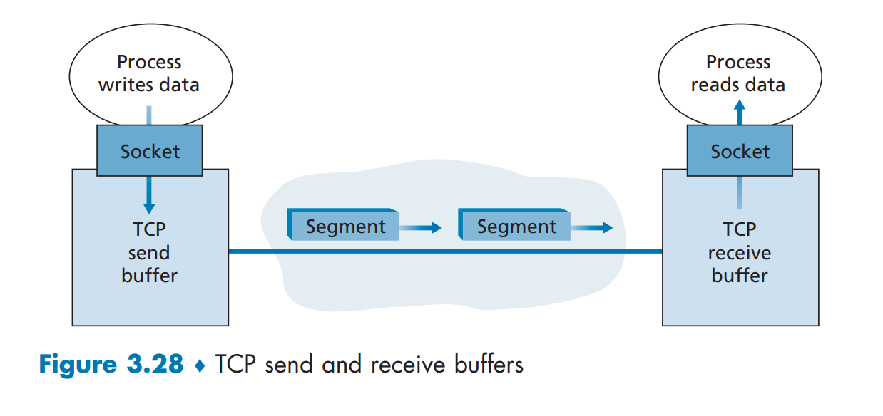
Establishment of connection
Client/Server Process
clientSocket.connect((serverName,serverPort)) > port identifies process on the server
Three Way Hand-Shake
Connection Establishment
Maximum Segment Size (MSS) - Largest Link Layer frame

Slide 6
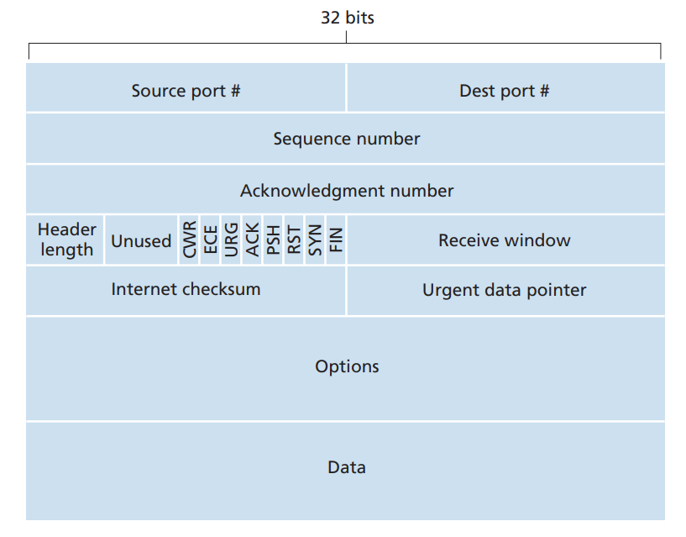
TCP Segment Structure
Header field
Data field
Source & Destination Ports
Checksum field(integrity)
Sequence number field
Acknowledgment number field

Slide 7
TCP Segment Structure
Receive window field
Header length field(32bit)
Options field (MSS)
Flag field(6 bits)
ACK, RST, SYN, FIN, PSH,URG

Slide 8
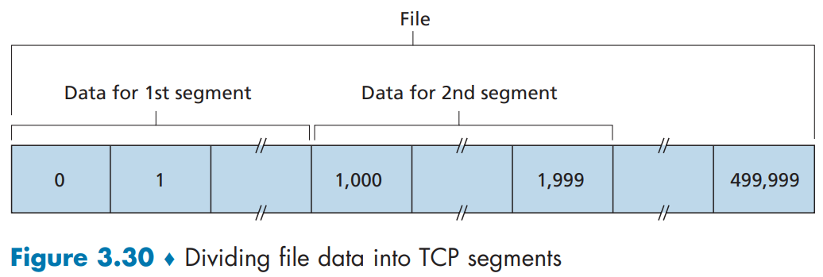
Establishment of connection
Sequence number for a segment
Acknowledgement Number

Slide 9
TCP Implementation
There are basically two choices:
the receiver immediately discards out-of-order segments
the receiver keeps the out-of-order bytes and waits for the missing bytes to fill in the gaps

Slide 10
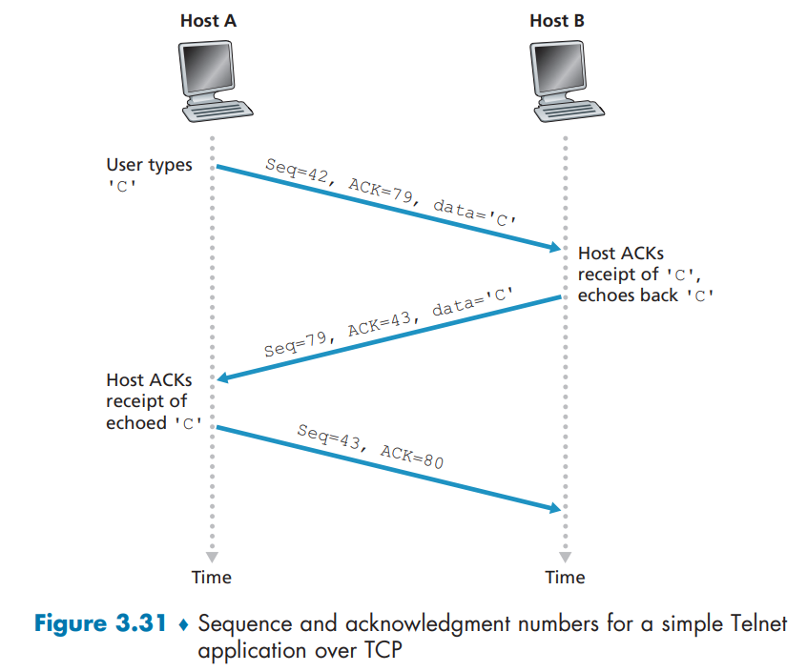
Telnet: A Case Study
Telnet, popular application-layer protocol used for remote login.
Unlike the bulk data transfer, Telnet is an interactive application.
Piggybacked

Slide 11
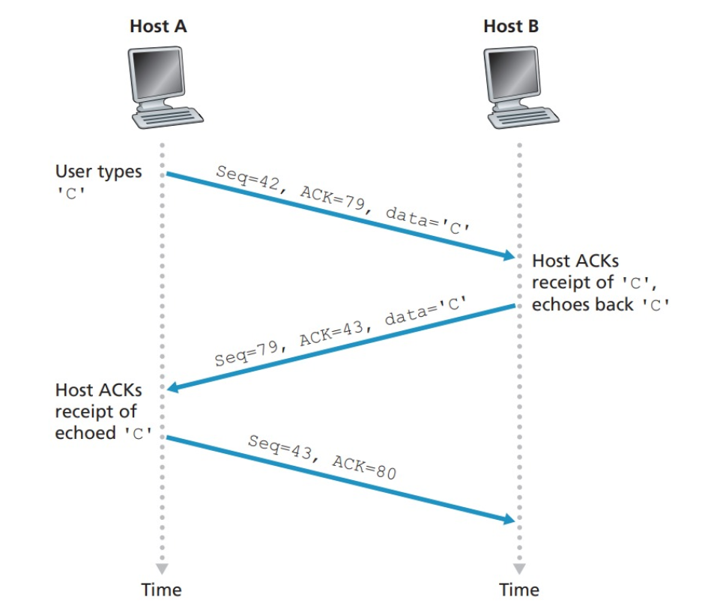
Round Trip Time
Amount of time between sent time and ack message time

Slide 12
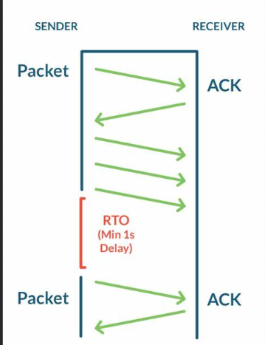
How to set TCP timeout value.
Longer than RTT
Issue: RTT varies
Too short than RTT:
Unnecessary timeout,
Too long than RTT:
Slow reaction to segment loss

Slide 13
How to measure RTT.
Sample RTT: measured time from segment transmission until Ack message received
Ignore retransmissions
Estimated RTT: average several sample RTTs, not just single RTT

Slide 14
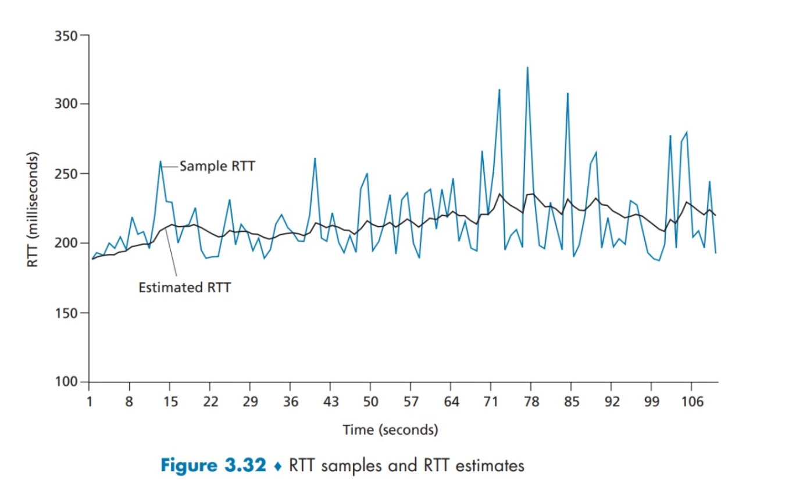
Estimated RTT.
Exponential weighted moving average(EWMA)
Influence of past sample decreases exponentially fast

Slide 15


Estimated RTT - cont
Typical value for α is : 0.125

Slide 16
Deviation RTT.
Deviation of SampleRTT from EstimatedRTT

Slide 17

Deviation RTT. - cont
The recommended value of β is 0.25.

Slide 18

Timeout Interval
An initial TimeoutInterval value of 1 second is recommended.
When timeout occurs, value of TimeoutInterval is doubled to avoid premature timeout and is again updated through the formula when the acknowledge message is received

Slide 19
Reliable Data Transfer
What is Reliable Data Transfer in TCP?
Reason to use this?
Three Events and Actions on it
Three Scenarios

Slide 20
What is Reliable Data Transfer
A Service which ensures that data received on the receiver side via TCP is...
Uncorrupted
1
In Sequence
2
Without Duplications
3
Without Gaps
4

Slide 21
Reason to use this & Re-Transmissions Triggered
Sending Data only To IP is Un-reliable
Sender is not confirmed that receiver received the data or not
Data that is send can be lost or Corrupted
Acknowledges
A Verification from receiver side to sender side when data is received
Re-Transmissions
When data is send to receiver. That data is marked as Not-Acknowledge
If the Timer out … then the Not-Acknowledge data is re-send to receiver

Slide 22
Three Events
Data Received
1
Timer Timeout
2
Acknowledge Received
3
When Sender received Data from Application
Data send but not acknowledge
Receiver send Acknowledge message to Sender

Slide 23
Actions on Three Events
Data Received
Create Segment with Sequence Number (= NextSeqNum)
Send Segment (to receiver)
Increment NextSeqNum with data-length
Start Time if not running
Timer Timeout
Re-transmit a Not-Yet-Acknowledge Segment
Start Timer
Acknowledge Received
If( y > Send Base ) { Send Base = y if(Not-Yet-Acknowledge Segment Present){ Start Timmer
}
}

Slide 24
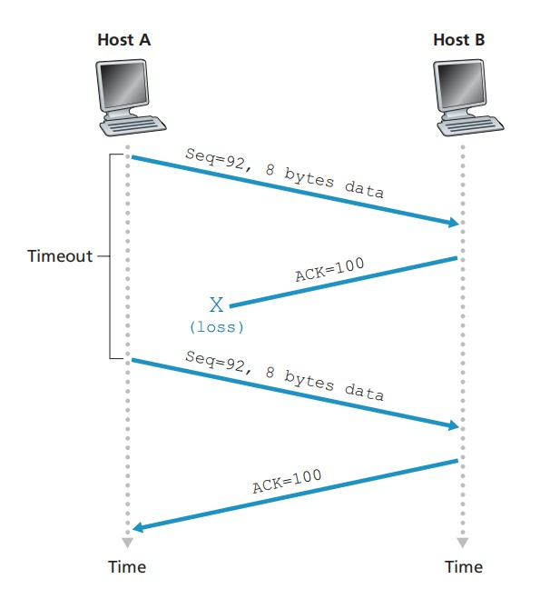
Retransmission due to a lost acknowledgement
Host A send data to Host B
Data is Send , But acknowledge is
not Received in terminal
Data again send
Acknowledgement Received

Slide 25
Segment 100 not retransmitted
Two Data Segment sends 92 and 100
Acknowledge not received in time
interval
Smallest Not-Yet acknowledge send
Segment 100 not send

Slide 26
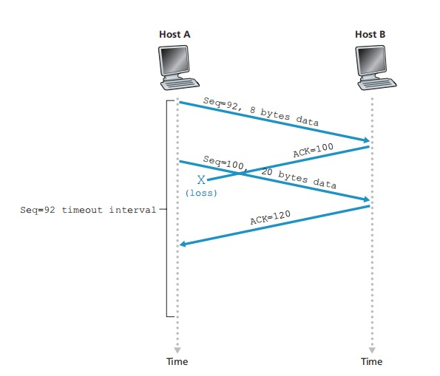
A cumulative acknowledgement avoid retransmission of the first segment
Segment 92 is send and Timer start
Acknowledge not received
Segment 100 is send within Timer
Acknowledge 120 received
segment 92 will not be resend

Slide 27
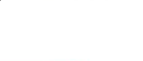
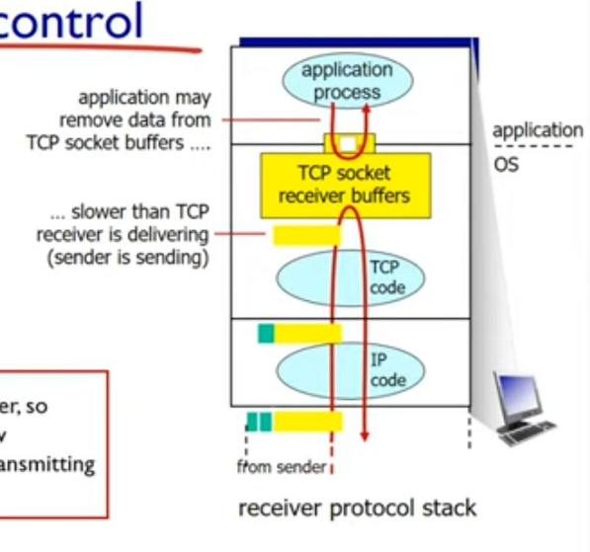
Flow Control
Receiver controls sender, so sender won't overflow receiver's buffer by transmitting too much, too fast.

Slide 28
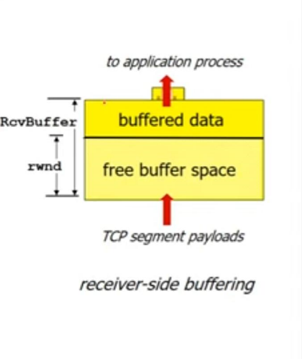
Flow Control
Receiver informs free buffer space by including rwnd value in TCP header of receiver-to-sender segments
RcvBuffer size set via socket options( default 4096 bytes)
Many operating systems auto adjust RcvBuffer

Slide 29
Flow Control
Sender limits amount of unacknowledged data to receiver's rwnd value.
LastByteSent – LastByteAck <= rwnd
Gaurantees receive buffer will not overflow

Slide 30
Flow Control – handling issue
As the sender gets blocked if the rnwd is full when, it will unblock?
Sender keeps on sending 1 byte for acknowledgement untill it is acknowledged.

